Slide 1
"Data-Driven Insights & Subscriber Prediction for Udemy Courses"
"Leveraging analytics to understand factors influencing course success."

Slide 2
Project Objective
The objective of this project is to analyze Udemy Finance & Accounting courses and develop a predictive machine learning model to estimate the number of subscribers based on key course attributes such as ratings, reviews, number of lectures, and pricing.
To perform data cleaning, exploratory analysis, and build a predictive model to understand the key factors affecting course popularity on Udemy.
To determine how course rating, reviews, pricing, and content structure influence the success of Finance & Accounting courses on Udemy.

Slide 3
Data Overview
----------------------------------------------------
Dataset Overview - Udemy Finance & Accounting Courses
----------------------------------------------------
• Records (Rows): 13,608
• Columns: 13 (after cleaning)
• Time Range: Courses created between 2015–2024
• Domain: Finance & Accounting (Online Learning)
• Price Range: $5 – $156
• Subscribers: 0 – 374,836 learners
• Source: Udemy Dataset (Project File)
Key Attributes:
• title, is_paid, price_detail__amount
• discount_price__amount, created, published_time
• num_subscribers (Target), avg_rating, num_reviews
• num_published_lectures, num_published_practice_tests

Slide 4
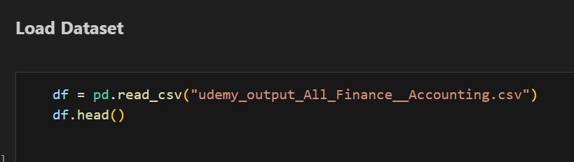
Firstly load the udemy dataset.
"df.head() displays the first 5 records of the dataset.
Each row represents a Udemy course and includes details such as pricing, ratings, number of subscribers, and publication timeline.
This helps us understand the dataset structure and begin data cleaning."

Slide 5
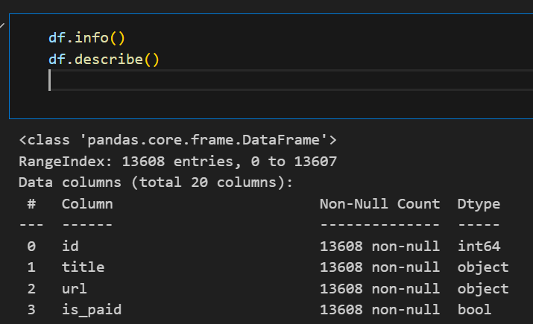
“The df.info() output shows that our dataset contains 13,608 records and 13 columns.
Most columns are numeric (int/float), while a few are object and datetime types.
There are no major missing values, making our data reliable for analysis.”
df.describe() provides statistical insights for all numeric columns

Slide 6
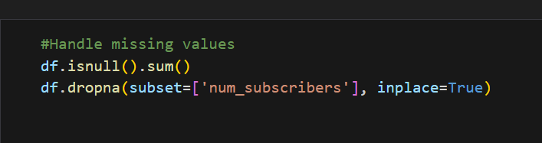
“We checked for missing values in the dataset.
The most important column for prediction was num_subscribers, as it is our target variable.
To ensure model accuracy, any record where num_subscribers was missing was removed from the dataset.”

Slide 7
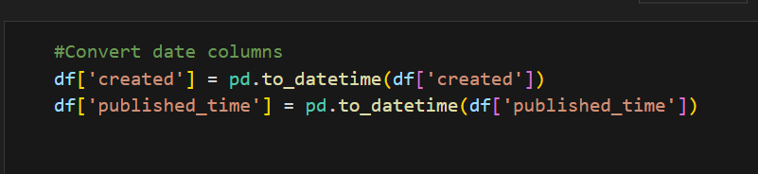
“The created and published_time columns were converted to datetime format using pd.to_datetime().
This allows us to perform time-based analysis such as course growth trends, launch patterns, and duration analysis.
Converting dates improves accuracy in visualizations and enables time series insights.”

Slide 8
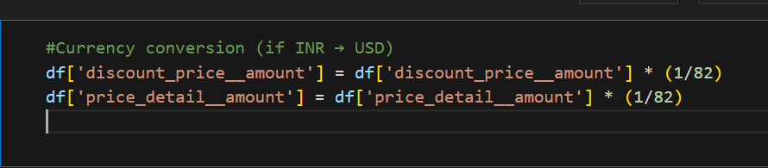
“The price-related columns (discount_price__amount and price_detail__amount) were originally in INR.
To standardize the dataset and make financial comparison consistent, prices were converted to USD using an exchange rate of 1 USD = ₹82.
This ensures meaningful analysis, especially for international audience and model performance.”

Slide 9
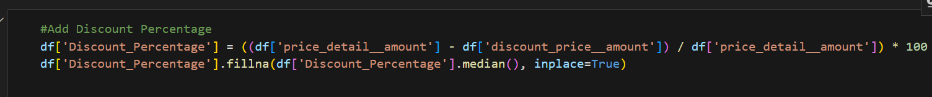
“A new feature named Discount Percentage was created to measure the discount impact on course pricing.
This helps analyze whether higher discounts attract more subscribers.
Missing discount values were replaced using the median, ensuring stable analysis without skewness.”

Slide 10
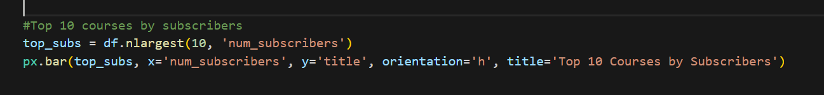
Extracted top 10 courses based on highest number of subscribers
Used horizontal bar chart for better readability of course titles
Shows most popular and in-demand courses on Udemy

Slide 11
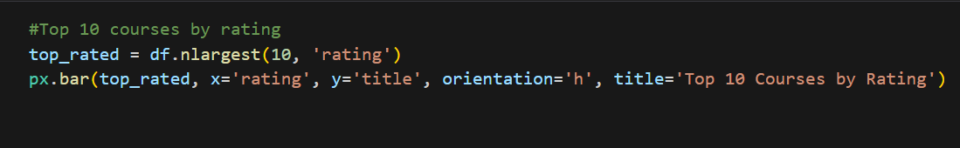
Selected top 10 courses with highest user ratings
Used horizontal bar chart for better comparison
Highlights courses with best student feedback and quality
Ratings are based on a 0–5 scale

Slide 12
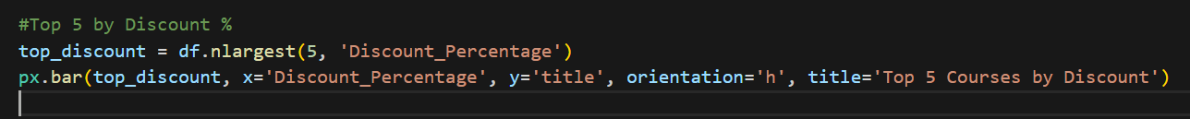
Selected top 5 courses with the highest discount percentage
Visualized using a horizontal bar chart
Helps understand which courses are offering the maximum price reduction
Useful for analyzing marketing strategies and buyer attraction

Slide 13
Visualizes how Udemy Finance & Accounting courses have increased over the years
Aggregated course count year-wise using publication date
Used line chart to show long-term trend
Helps understand platform growth and learner demand

Slide 14
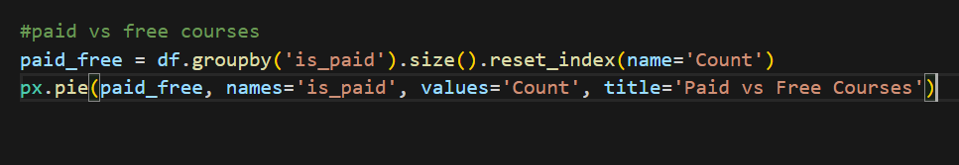
Performed comparison between paid and free courses
Grouped dataset using is_paid column
Represented results using a pie chart
Helps understand course pricing trend on Udemy

Slide 15
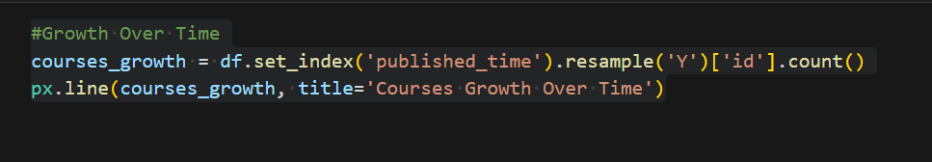
Resampled course data year-wise based on publishing date
Used line chart to display growth of courses over time
Helps track evolution of course development and learner demand
Shows how Udemy’s Finance & Accounting domain has expanded

Slide 16
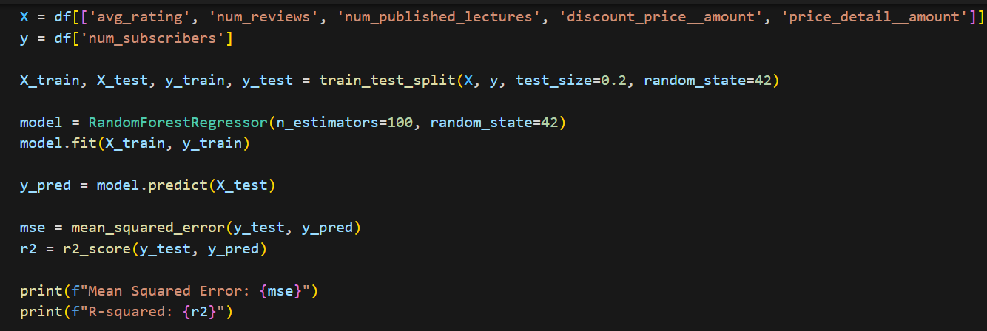
Predictive Analysis
Selected independent variables (X):
avg_rating, num_reviews, num_published_lectures, discount_price__amount, price_detail__amount
Target variable (y) → num_subscribers
Split data into 80% training and 20% testing
Trained Random Forest Regressor (100 trees)
Predicted subscriber values on test data
Evaluated model using:
Mean Squared Error (MSE)
R-squared (R²) Score

Slide 17
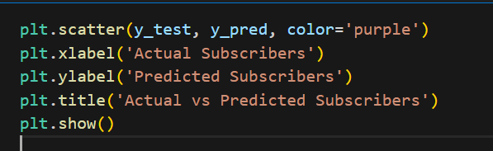
Plotted actual vs predicted subscriber values using a scatter graph
Each point represents a course from the test dataset
Points closer to an imaginary diagonal line (y = x) indicate accurate predictions
Helps evaluate how well the Random Forest model performed

Slide 18
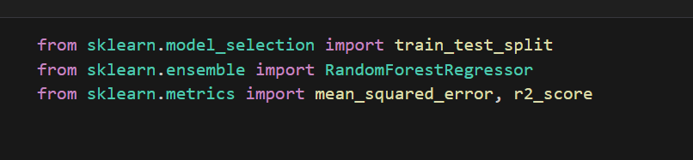
“We imported the required machine learning tools from Scikit-Learn.
The train_test_split method was used to divide the dataset,
RandomForestRegressor was used to build our prediction model,
and finally, mean_squared_error and r2_score helped us evaluate model performance.”

Slide 19
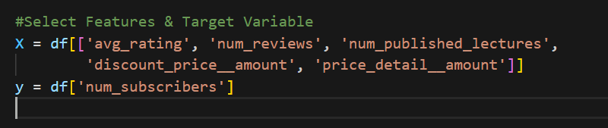
avg_rating → Indicates course quality and learner satisfaction
num_reviews → Reflects engagement and popularity of the course
num_published_lectures → Shows the amount of content provided
discount_price__amount → Final discounted selling price
price_detail__amount → Original course price before discount

Slide 20
Divides the dataset into two parts:
80% – Training data (used to train the model)
20% – Testing data (used to evaluate model performance)
test_size=0.2 → 20% of data is reserved for testing
random_state=42 → Ensures same split every time (reproducibility)
Helps verify whether the model generalizes to unseen data

Slide 21
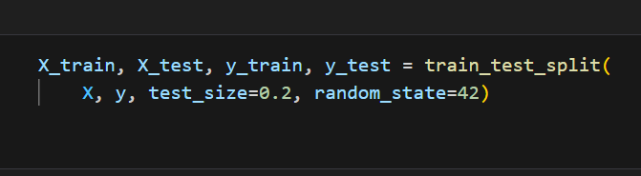
Divides the dataset into two parts:
80% – Training data (used to train the model)
20% – Testing data (used to evaluate model performance)
test_size=0.2 → 20% of data is reserved for testing
random_state=42 → Ensures same split every time (reproducibility)
Helps verify whether the model generalizes to unseen data

Slide 22
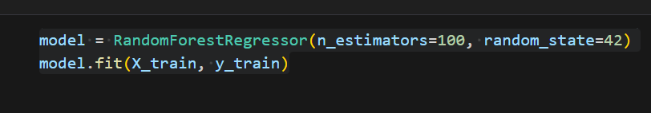
RandomForestRegressor is selected as the machine learning algorithm
It uses 100 decision trees (n_estimators = 100) to make predictions
random_state=42 ensures consistent and reproducible results
model.fit(X_train, y_train) → Model is trained using training data
Learns patterns and relationships between course features and number of subscribers

Slide 23
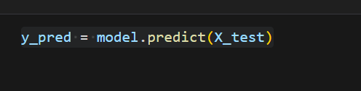
After training the model, we use it to make predictions
model.predict(X_test) → Predicts subscriber count for the test dataset
Uses input features (X_test) to generate predicted values
Results are stored in y_pred, which we later compare with actual values (y_test)
This step helps evaluate how accurately the model can predict course subscribers

Slide 24
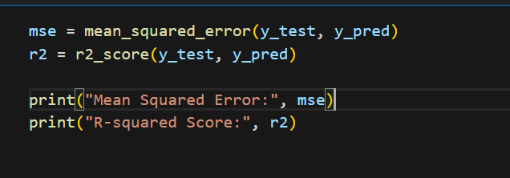
Evaluates how well the model predicts subscribers
mean_squared_error() → Measures how far the predictions are from actual values
Lower value = better performance
r2_score() → Indicates how accurately the model explains the variance
Value closer to 1 = higher accuracy
These metrics help determine whether the model is reliable and efficient

Slide 25
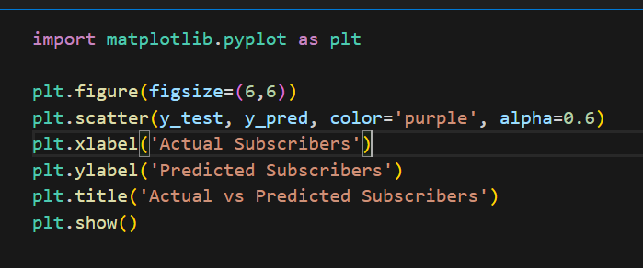
Created a scatter plot to compare:
Actual subscriber values (y_test)
Predicted subscriber values (y_pred)
Used purple-colored dots with slight transparency (alpha=0.6)
Plot helps visually evaluate model accuracy
If points are close to a diagonal line, predictions are good
Indicates how well the model generalizes to unseen data

Slide 26
Tools & Technologies
Data Handling & Analysis
Python → Core programming language
Pandas → Data cleaning, preprocessing, handling missing values
NumPy → Numerical operations
Data Visualization
Matplotlib → Line charts & scatter plots
Plotly Express → Interactive bar charts, pie charts, and other visual insights
Machine Learning & Prediction
Scikit-learn (sklearn)

Slide 27
Key Insights
Strong growth trend – Number of Finance & Accounting courses increased significantly after 2016, indicating high demand for online learning.
Majority of courses are paid, showing that learners are willing to invest in premium content.
Course quality strongly influences subscribers
Higher ratings & reviews lead to more enrollments
More published lectures = higher learner attraction
Excel, Accounting, Business & Financial Analysis are among the most popular topics.
Discounts help promotional reach, but high discount alone doesn’t guarantee high subscribers.
Random Forest prediction model performed well
Low MSE (less prediction error)
High R² score (good accuracy)

Slide 28
Business Value
Identifies high-demand course topics (e.g., Excel, Finance, Accounting), helping platforms like Udemy decide where to invest for content development.
Helps instructors design better courses by focusing on factors that increase subscribers:
Improve ratings & reviews
Add more structured lecture content
Provide valuable learning outcomes
Supports pricing strategy decisions
Analysis shows that quality has more impact than discount
Businesses can price courses appropriately without relying heavily on discounts.

Slide 29
Conclusion
The analysis shows a strong upward trend in Finance & Accounting course development, especially after 2016, reflecting the rising demand for online professional education.
Paid courses dominate the platform, indicating that learners are willing to invest in high-quality knowledge rather than relying on free sources.
Course quality factors such as ratings, number of reviews, and number of lectures significantly influence the number of subscribers.

Slide 30
Thank You

